Slide 1
Dr. Markus Pauli The Politics of Microfinance and the Politics of State, Market & Civil Society Partnerships
1st Singapore Public Policy Conference 2016

Slide 2
Structure
The Politics of Microfinance
Research Questions
Idea & State of Microfinance
The Role of Politics in Boom and Bust
Perception
Conclusion
The Politics of State, Market & Civil Society Partnerships Dominance of Partnerships
Case Study: Grow Asia
Conceptual Framework
Research Questions

Slide 3
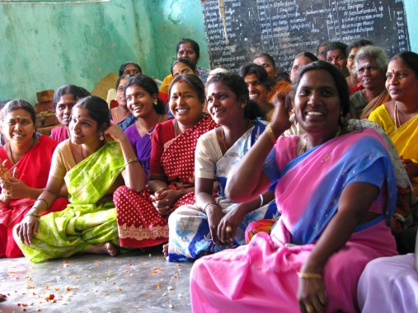
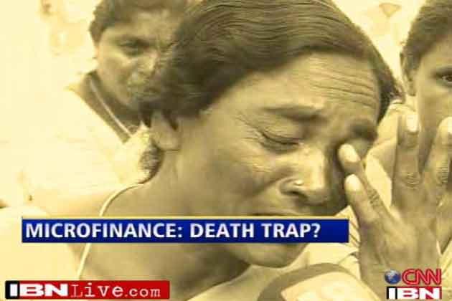
Credibility of Microfinance
Directly Empowering
Poor People
Worse than
Moneylenders
Notes:
"much more than simply an income generation tool. By directly empowering poor people, particularly women, it has become one of the key driving mechanisms towards meeting the Millennium Development Goals”
Mark Malloch Brown, United Nations Deputy Secretary-General
Like Subprime Lending, Reserve Bank of India Governor, Yaga Venugopal Reddy

Slide 4
Puzzles & Research Questions
Why Huge Success & Severe Crises?
… in India?
Politics
Why Millions Take Microfinance?
Perception in Andhra?

Slide 5
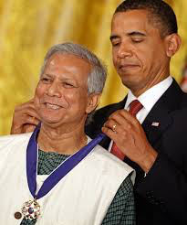
Why Microfinance?
The Idea
Muhammed Yunus
Grameen Bank
Outreach
100 million
Potential
$ 76 billion
1 out of 4
Borrowed from Bank
Notes:
DFI e.g. KfW
development aid by OECD = USD 135.2 billion (2013)
(official development assistance (ODA)

Slide 6
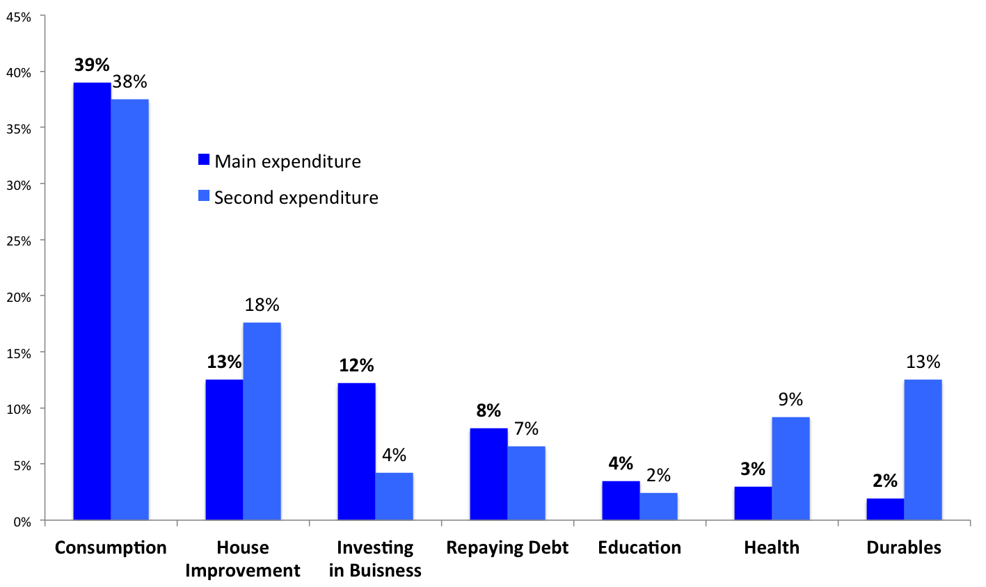
What is Microfinance?
Group Liability
33%
Interest
Multiple Loans
Investing
versus
Consuming
Primary Data, 2013
Notes:
(Two to Three) (10 000 Rupees)
⬥ Consumption (main: 39%, second: 38%)
⬥ House Improvement (13%, 18%)
⬥ Investing in Existing/ New Business (12%, 4%)

Slide 7
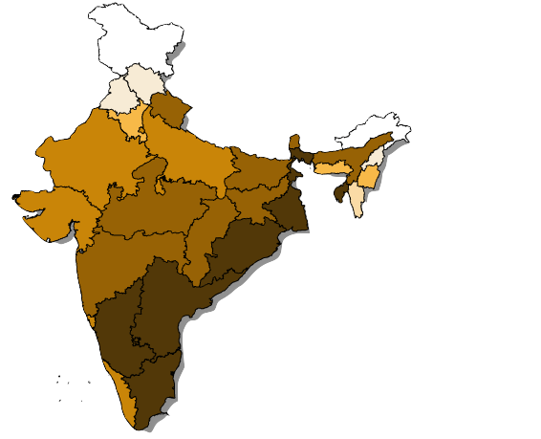
Why India?
Why Andhra?
Clients in million
Microfinance
Institutions
33
Andhra
Pradesh
State-Run SHG
Bank-Linkage
57
92% Women
Notes:
1 Followed by Bangladesh (18.5 million in 2013)

Slide 8
The Microfinance Story in India: Boom & Bust
Priority Sector Lending
“Quest for Numbers”
Over-Indebtedness
State-Market-Conflict
Microfinance Ordinance
- 30,000 Staff
- US$ 1 Billion
Notes:
1 co-operatives & nationalized banks
2 e.g. Worldbank in Andhra
“Eating into” Government-Run Bank Linkage
Microfinance Act
Result: US$ 1 Billion Loans Writing Off,
30,000 Staff Members Laid Off
Supreme Court & Microfinance Bill

Slide 9
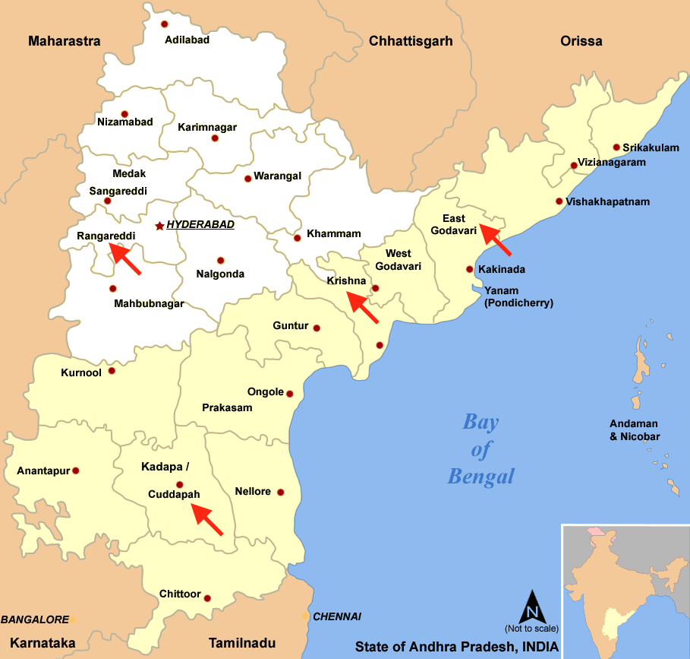
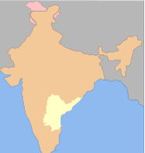
Survey
CSDS
Regions
& Outreach
Randomized
Multistage
Sampling
562
Notes:
Source: Wikimedia Commons, http://commons.wikimedia.org/wiki/File:Telengana.PNG, April 21st 2015.

Slide 10
Findings on the Perception of MFIs
+
(Very) Good
67%
to 82%
SKS
Easy Approval
Convenience
Multiple Loans
–
Rude Staff
Pressure
Valued
Despite
Criticism
VERY BAD
VERY GOOD
Notes:
→ “easy money”

Slide 11
Conclusion
No Alternative to Growth & Job Creation
Industry Building
Reduction of Vulnerabilities
& Dependencies
Politics
Institutions
Development
Agency
Notes:
Microfinance (incl. Savings & Insurances) Can Contribute to….
Transition from Traditional Agrarian to Modern Society through…

Slide 12
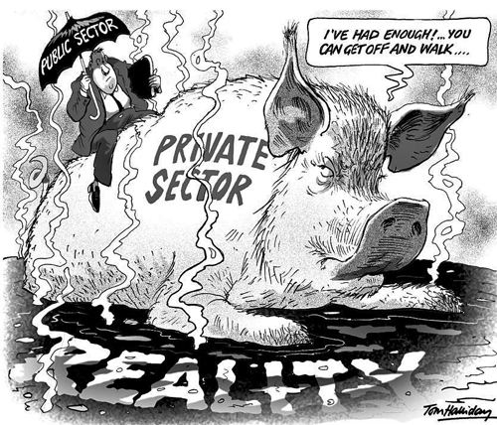
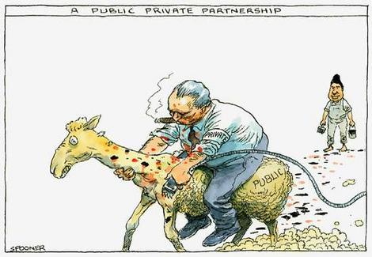
Dominance of Partnerships

Slide 13
Case Study:
Initiated by World Economic Forum, partner: ASEAN
Aim: Reach 10 (of ~100) million smallholder farmers in South-East Asia by 2020 -> increase income & food security and reduce negative environmental impact
Country-led ♦ Multistakeholder ♦ Market-based ♦ Aligned with national plans

Slide 14
Conceptual Framework
Emerson et al.: workings of collaborative governance
system context
drivers of collaboration
dynamics of collaboration
collaborative actions
impacts & adaptations
Risse, Börzel at al.: “governance without a state”
in areas of “limited statehood”.

Slide 15
Research Questions
Participation
Empowerment
Capacity Building
Collaboration
Implementation
Political Economy Context
Interests
Resource Allocation
“Mission Drift”
Legitimacy & Accountability

Slide 16
Thank you!

