Slide 1
Technological and Political Rationalities of Smart City Initiatives in China: An Empirical Analysis
Yu Wenxuan & Xu Chengwei
Public Policy and Global Affairs (PPGA),
School of Humanities & Social Sciences
Aug 26-27, 2016

Slide 2
Outline
Introduction
Theories and assumptions
Methods and results
Conclusion

Slide 3
Smart city as an ideal model for cities in the future
Global urbanization
54% population in 2014
66% in 2050
Urban illness
Consuming 75% resources
Producing 60-85% GHG emissions (UNDP 2012)
Pollution, traffic jam, food security,low fertility and aging (United States 2014)
smart governance and smart growth?
environmental and social substantiality
ICT technologies
Smart city as a solution packager
Smart city technologies investment
8.1 billion, 2010; 39.5 billion 2016

Slide 4
Understanding smart city
a smart city is an “instrumented, interconnected and intelligent city.” (Harrison et al, 2010)
to capture live real-world data on the environment, urban life and public service delivery through the use of sensors, meters, cameras, personal devices for conducting complex analysis, modeling, optimization, and visualization to facilitate effective and efficient decision and public policy making.
preserving history, cultivating social capital, encouraging creativity and social learning, encouraging healthy life style, citizen participation in public life and cross-sectoral collaborations.

Slide 5
Understanding smart city
Smart City
Smart economy
Smart people
Smart governance
Smart living
Smart environment
Smart mobility
Source: Giffinger, et al (2007)

Slide 6
A different route of smart city initiatives in China
pushed and pulled by different political, economic and social forces and rationales
economic slowdown, terrible environment pollution
inferior public service deliveries and social security net
rampant political corruption
prevalent urban pathologies :traffic jam, food security and social safety
Top-down or bottom-up
International experience:IBM and Cisco
Political support:
the 12th Five-Year Plan; three ministries involved
Government as a leading role

Slide 7
Smart city as a national program in China
Ningbo in 2009.
China’s Ministry of Housing and Urban-Rural Development
selecting cities to experiment
implement smart city initiatives
296 in 2015
the performances of smart city initiatives vary significantly across localities in China (Chinese Academy of Social Sciences and Beijing Govmade Smart City Research Centre, 2015, Zhang, Chen & Song, 2015)
why?
lack of quantitative empirical studies

Slide 8
Government innovation diffusion theories
Innovation diffusion:
external factors such as political and economic environment, culture, industrialization, party politics
internal factors such as organizational resources, leadership and learning capacity all influence government innovation diffusion (Berry & Berry 1990 1992; Graham, Shipan &Volden, 2013; Rogers, 1983).
policy diffusion (Zhu & Zhang, 2015; Zhou & Li, 2014; Ma, 2013 & 2015)
Ｓmart city as a government innovation

Slide 9
H1a. The more financial, the better performance.
H1b. The more human capital, the better performance.
Smart city development
Resources
Culture
Institutional support
Leadership
Policy demand
H4. The stronger the institutional, the better performance
H2. The more open the culture of a city, the better development
H3. The stronger the executive leadership, the better performance
H5. The more serious the urban challenges, the better development

Slide 10
Data and Methods
Variables | Measurement | Source
Dependent Variable
Smart City Development (SCD) | Evaluation Score of 151 Smart City Development in China | 2015 Smart City Evaluation report by Beijing Govemade Information Consulting Co. Ltd. 2015
Independent Variables
Resource
Financial Resource (FRES) | City Budget Revenue per capita | China City Statistical Yearbook 2014
Human Capital (HCAP) | The ratio of the number of students enrolled in high education institutions to the total population | China City Statistical Yearbook 2014
Culture
Foreign Direct Investment (FDI) | Foreign Direct Investment per capita | China City Statistical Yearbook 2014

Slide 11
Leadership
Age (AGE) | Incumbent Mayor's Age | City Websites
Education (EDU) | Incumbent Mayor's Education
Institutional Support
Party Sectary (PSEC) | A dummy variable If the leader of the SC leading group is the Party Sectary, it is 1, otherwise ) | Respective City Websites
Mayor (Mayor) | A dummy variable If the leader of the SC leading group is the Mayor, it is 1, otherwise ) | Respective City Websites
Vice mayor or agency head (VAHEAD) | A dummy variable If the leader of the SC leading group is a vice mayor or agency head, it is 1, otherwise ) | Respective City Websites
Other | A dummy variable if the leader of the SC leading group is not indicated
Policy Demands
Population (POP) | Total Population within a city | China City Statistical Yearbook 2014
Pollution (POLL) | PM2.5 Density in every 10 micrograms per cubic meter (μg/m3) | http://www.pm25.in/rank

Slide 12
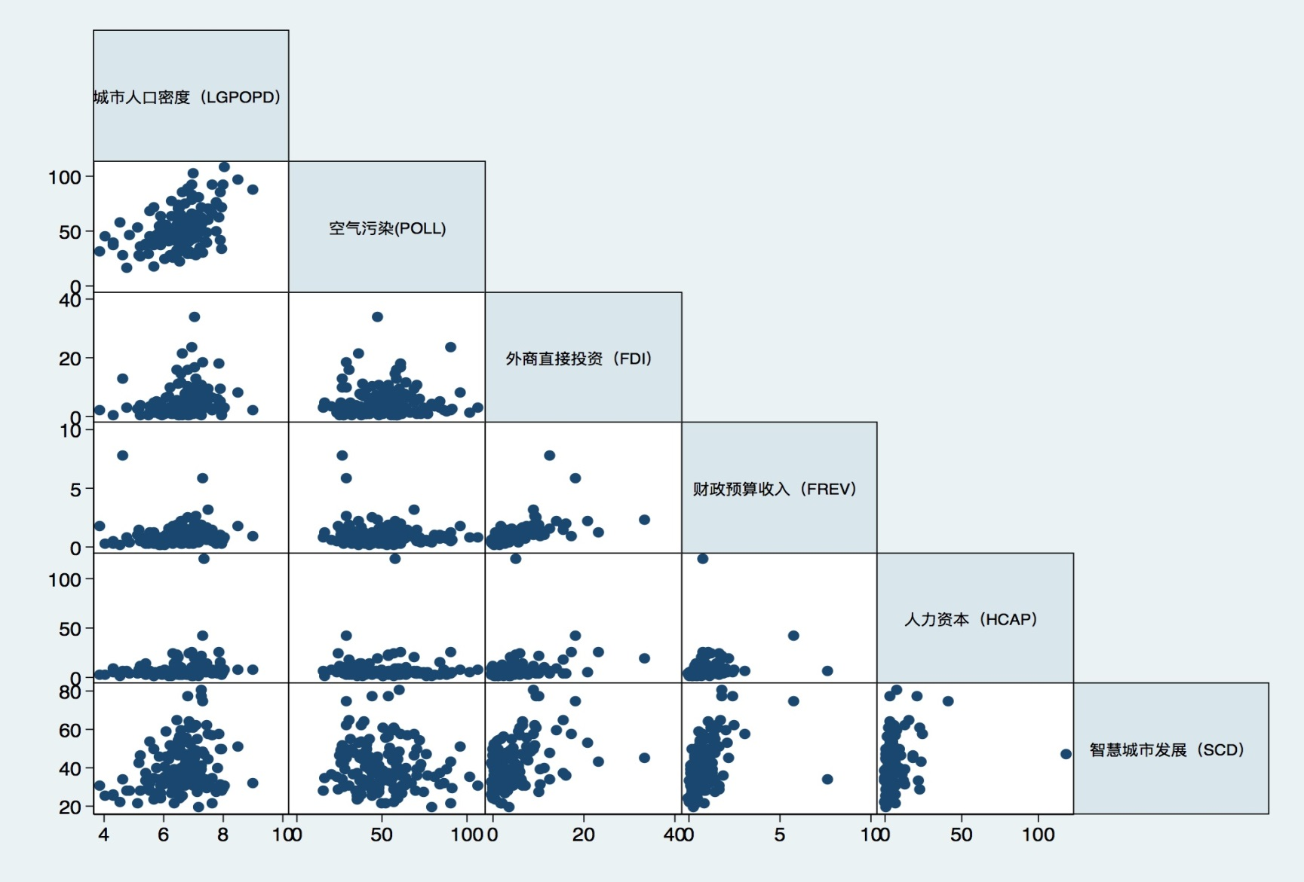
* Policy demand (Pollution and Population dencity) may have a curvilinear bell shape relationship with the dependent variable

Slide 13
 | Model I |  |  |  | Model II
Independent Variables | Coef. | Std. Err. | t | P>|t| | Corf. | Std. Err. |  | t | P>|t|
IGPOPD | 4.47 | 1.25 | 3.58 | 0.00** | 33.64 | 9.44 |  | 3.56 | 0.00**
IGPOPD2 |  |  |  |  | -2.26 | 0.72 |  | -3.13 | 0.00**
POLL | -0.18 | 0.05 | -3.68 | 0.00** | -0.16 | 0.05 |  | -3.3 | 0.00**
PSEC | 12.32 | 5.14 | 2.4 | 0.02* | 12.12 | 4.98 |  | 2.43 | 0.02*
MAYOR | 2.13 | 1.71 | 1.25 | 0.22 | 2.9 | 1.69 |  | 1.69 | 0.09
AGE | 0.19 | 0.24 | 0.81 | 0.42 | 0.29 | 0.23 |  | 1.26 | 0.21
EDU | 0.15 | 1.58 | 0.1 | 0.92 | 0.49 | 1.52 |  | 0.32 | 0.75
FREV | 3.2 | 2.42 | 1.32 | 0.19 | 4.15 | 2.4 |  | 1.73 | 0.09
FDI | 0.28 | 0.32 | 0.89 | 0.38 | 0.15 | 0.31 |  | 0.49 | 0.63
HCAP | 0.13 | 0.073 | 1.81 | 0.07 | 0.15 | 0.08 |  | 1.93 | 0.06
Cons | 1.95 | 15.03 | 0.13 | 0.9 | -99.05 | 36.09 |  | -2.74 | 0.01
 | Obs = 135, F(9, 125)= 6.2, Prob > F = 0.00 R-squared = 0.36 |  |  |  | Obs = 135, F(9, 124)= 7.37 Prob > F = 0.00 R-squared = 0.40
*= Significant at 0.1 level, ** =Significant at 0.05 level, **=Significant at 0.01 level

Slide 14
Findings and Discussions
Both policy demand variables, Population (POP) and Pollution (POLL), are statistically significant at 0.01 level, which fully support the policy demands hypothesis that smart city initiatives are problem-oriented and are driven by practical needs.H5 is supported.
Another interesting finding was that the party secretary as the Chief of the Smart City Leading Group (PSEC) is significant at 0.01 level, it shows that institutional support is crucial for the success of smart city initiatives. Thus H4 is supported.
Other Hs are not supported by present study.

Slide 15
The surprisingly significant curvilinear relationship between smart city development and pollution indicates that the relationship between smart city development and pollution is not linear.
It makes sense that smart city is a holistic solution to address many urban problems.
But as pollution gets more serious, smart city development slows down. For cities suffering serious pollutions, developing smart city initiatives were not their top priority.
In government innovation diffusion theories, political rationalities, aside from technical rationality, such as political culture and party politics are also very important
In China, the ruling CCP dominate and control the executive branch largely through its cadre personn
Since 2012, smart city initiatives have been strongly promoted by the Chinese central government, being highlighted in the 12th 5-years plan and the 13th 5-years plan.
Developing smart cities are already a political mission
The party secretary’s political support matters for smart city development

Slide 16
Conclusion
We constructed an explanatory model to explain the variance in the development of smart city.Both technological and political rationalities matter.
Large cities are more likely to adopt and implement smart city initiatives to address city problems.
Cities with high policy demanads are more likely to implement smart city initiatives, the development of smart city in cities with very serious environmental pollutions or population density is less satisfactory, because smart city initiatives would not be their priority.
Smart city initiatives are not only a technical policy solution, but also a political mission.
Political and institutional supports from party secretaries are crucial for smart city development in China.

Slide 17
Thank you!

