Slide 1
Academia vs Internet: New Issue Attention (Mega-) Cycle Model
SPPN Conference
Lee Kuan Yew School of Public Policy, NUS
Singapore, August 27 2016

Slide 2
Intro
Agenda-setting: the most critical policy cycle stage with issues emerging and competing for gov’s attention (Howlett et al. 2009; Wu et al. 2010); it recognizes the power of placing items into agenda and keeping others off the table (Mayo 2011).
Political conflict (Schattschneider 1960)
Issue characteristics (Cobb & Elder 1983)
Kingdon 1984, three streams & focusing events
Downs 1972, issue attention cycles

Slide 3
Downs original model (1972)
In 1972, the Issue Attention Cycle model was officially published (Downs, 1972).
5 stages:
Pre-problem stage: an undesirable social condition is not yet widely recognized by society, but some experts might already begin to understand it
Discovery and euphoric enthusiasm by society
Realizing the cost involved
Gradual waning of attention
Post-problem stage

Slide 4
Purpose of the Project
To explore what Downs only briefly suggested as some possible time gap between stage 1 (some experts begin to see the issue) & stage 2 (discovery by society)
For the purpose of this project, “experts” are defined in the academic sense, e.g. scholars or academic experts and publishers.
Contribution (theory): move beyond the Downs model by offering a New Model based on (possibly) parallel academia and the Internet cycles
Contribution (practical): to allow govs & NGOs to better predict spikes in social attention

Slide 5
Methodology
Web of Science database for collecting data on academia-driven attention cycles to corruption, based on the number of publications per country over the period of 1997-2015
Factiva (software) database for collecting data on the Internet driven attention cycles, based on the number of mentions per country
Comparative content analysis of online articles, blogs etc. as appear in Factiva and of academic publications that occur around peaks in attention, to observe patterns, “anchors”, key actors etc.

Slide 6
Criteria for country selection
Key criteria: developed or upper middle income nations ($9,000+ per cap GDP) except top 5 of IT rankings, with population size at least 10 MLN, excl. repressive and/or closed regime states.
Countries analyzed: UK, AUS, CAN, FR, ND, IT, SP, KAZ, PL (more will be added, incl. ARG, Chile, UAE, Saudi, SA, Turkey etc.)

Slide 7
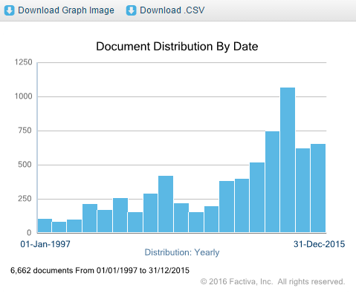
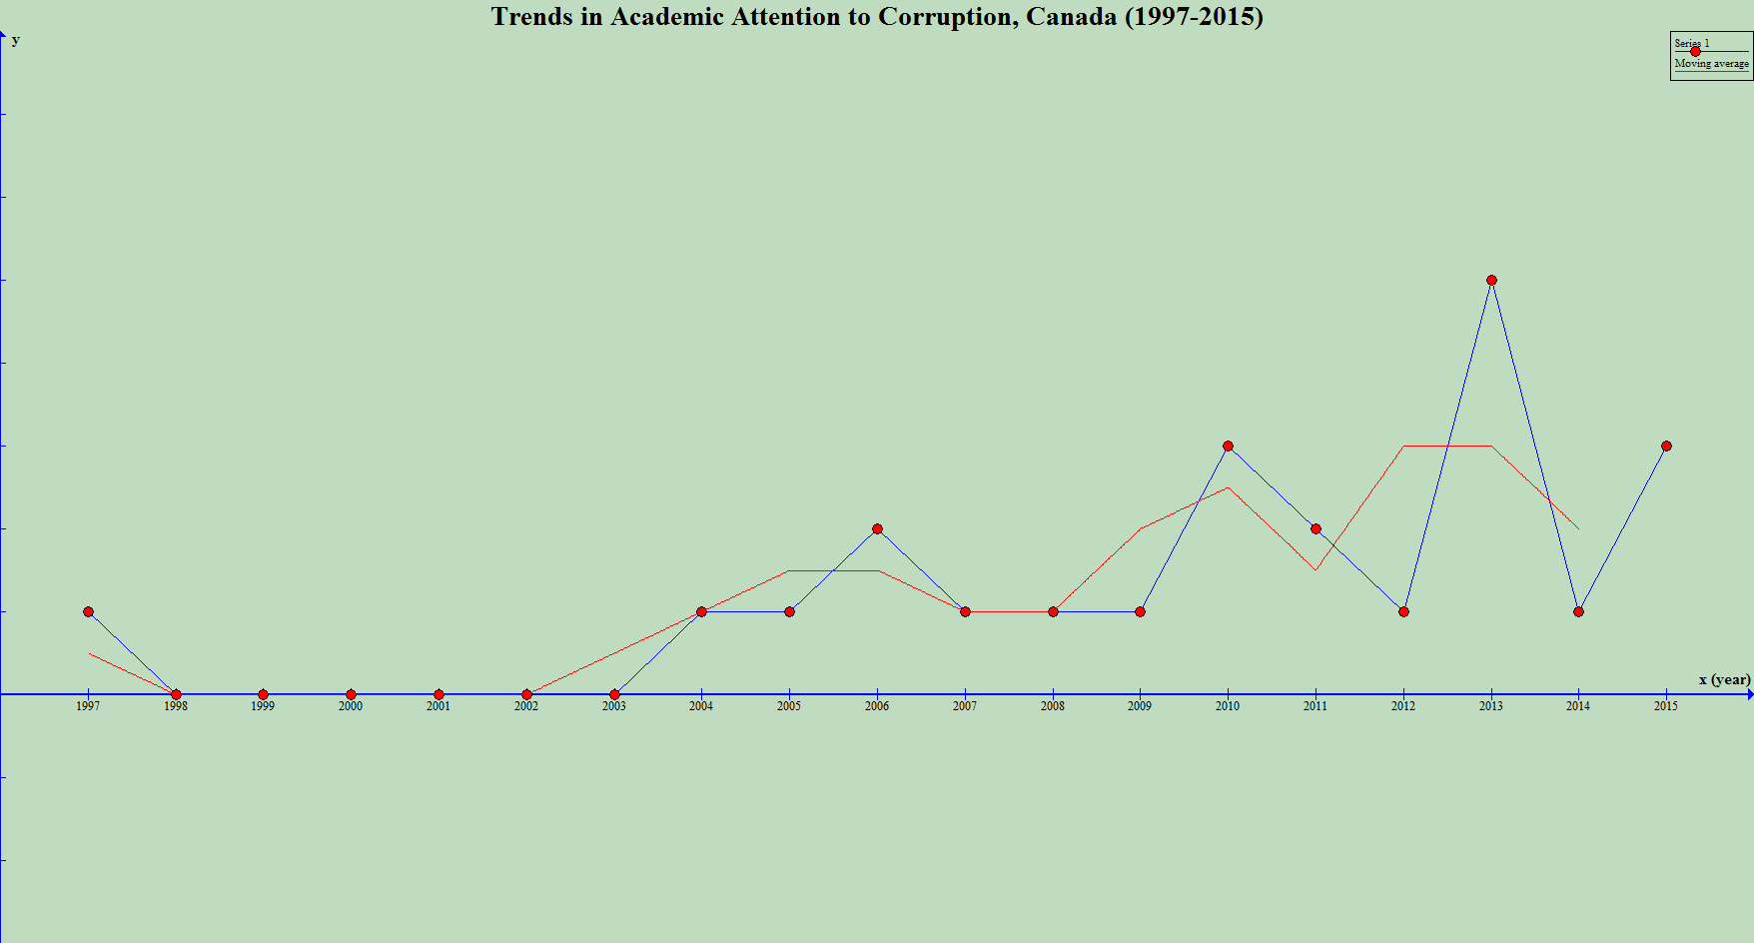
Countries Analyzed
Canada – good predictive power

Slide 8
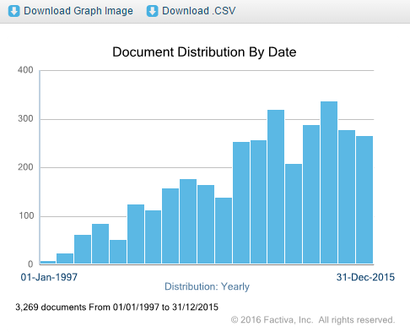
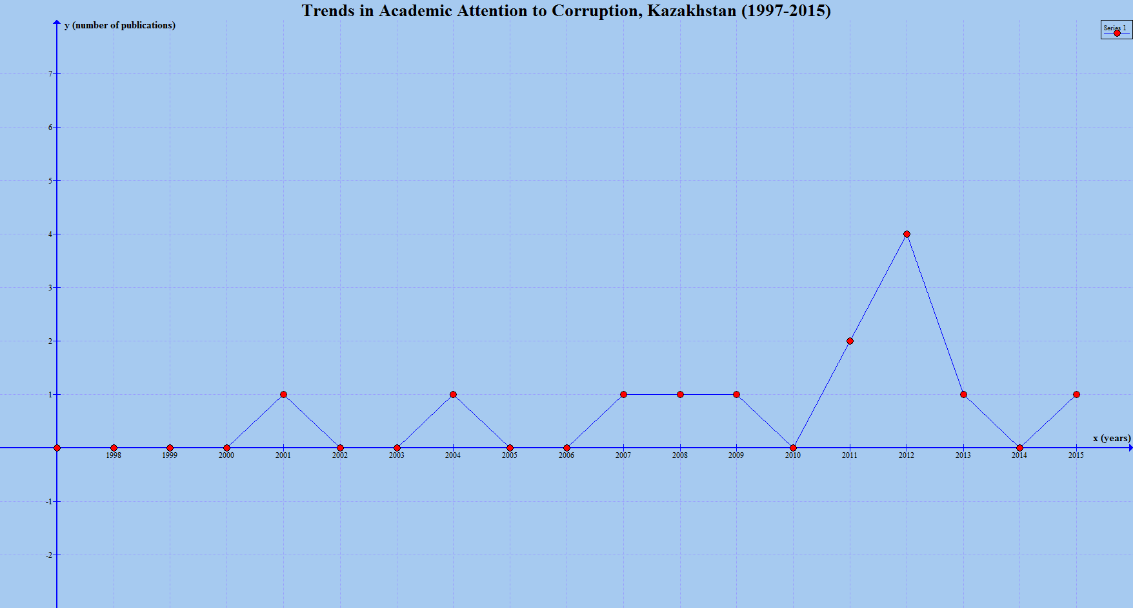
Countries Analyzed
Kazakhstan – academia reacting to media & public
(with moderate/weak predictive power)

Slide 9
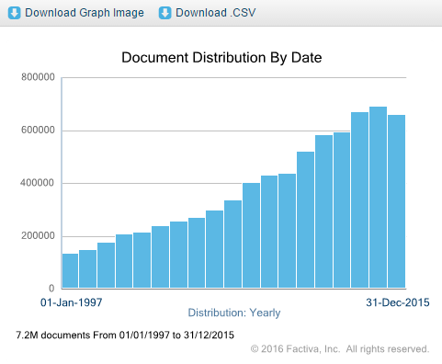
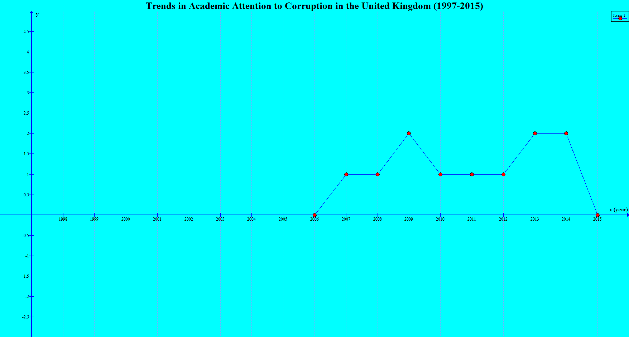
Countries Analyzed
The United Kingdom (UK) – academia in “sleep mode” (not even reacting)

Slide 10
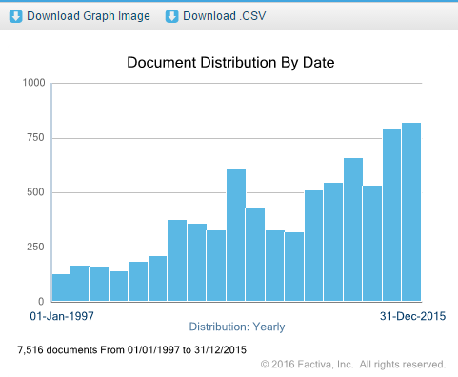
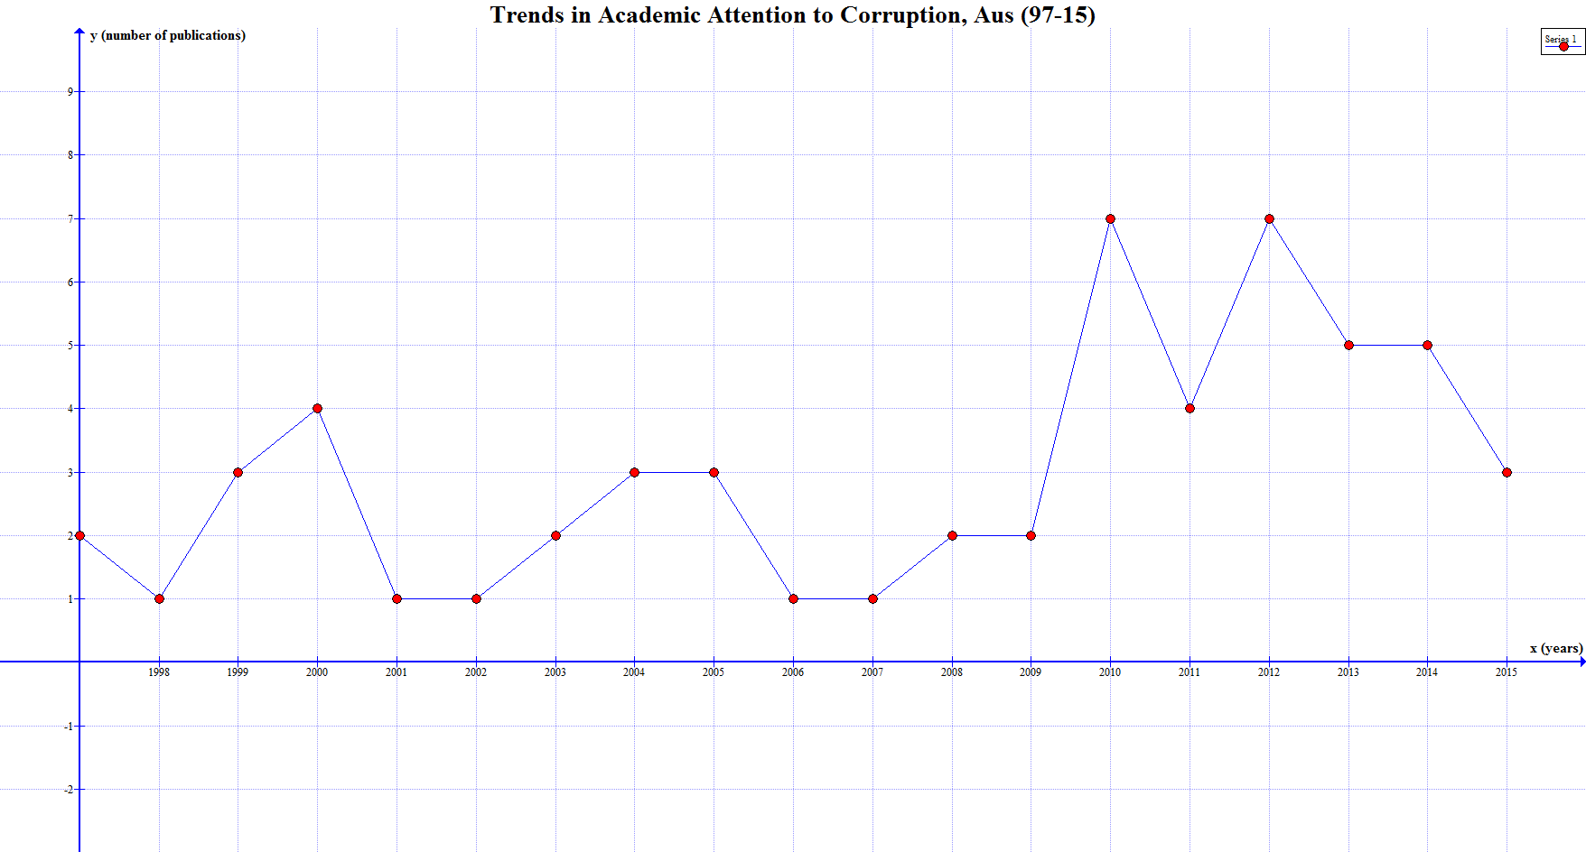
Countries Analyzed
Australia – “reactionary” academia vs the Internet

Slide 11
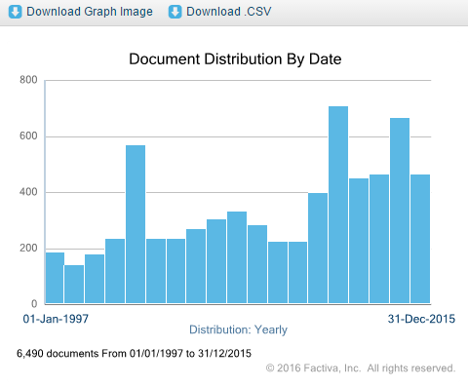
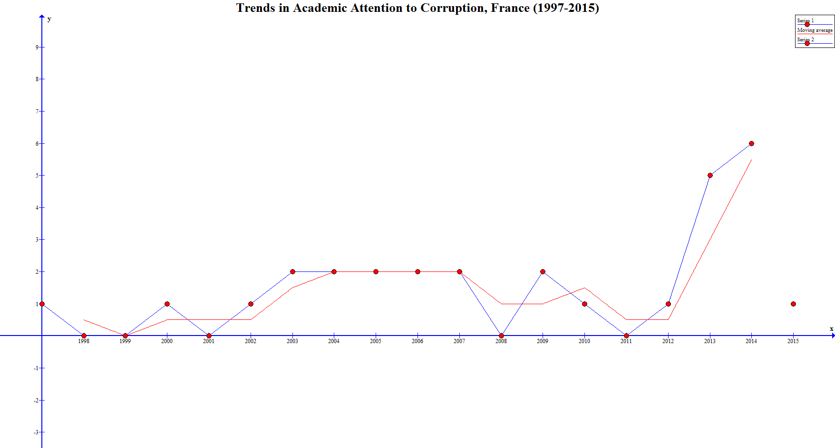
Countries Analyzed
France – academia in “sleep mode”

Slide 12
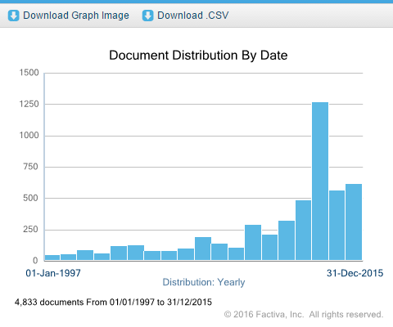
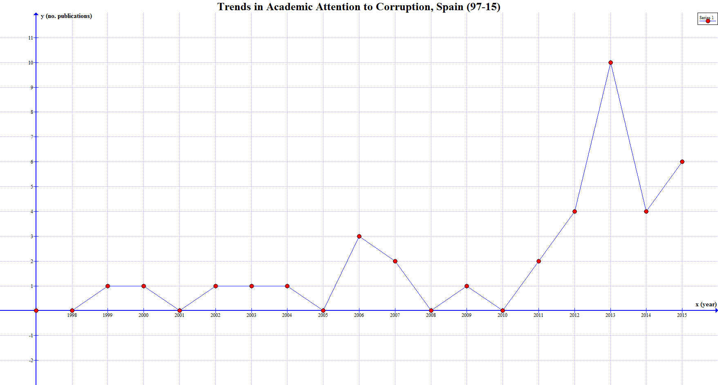
Countries Analyzed
Spain – good predictive power

Slide 13
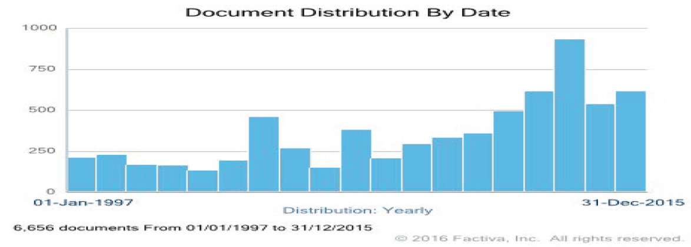
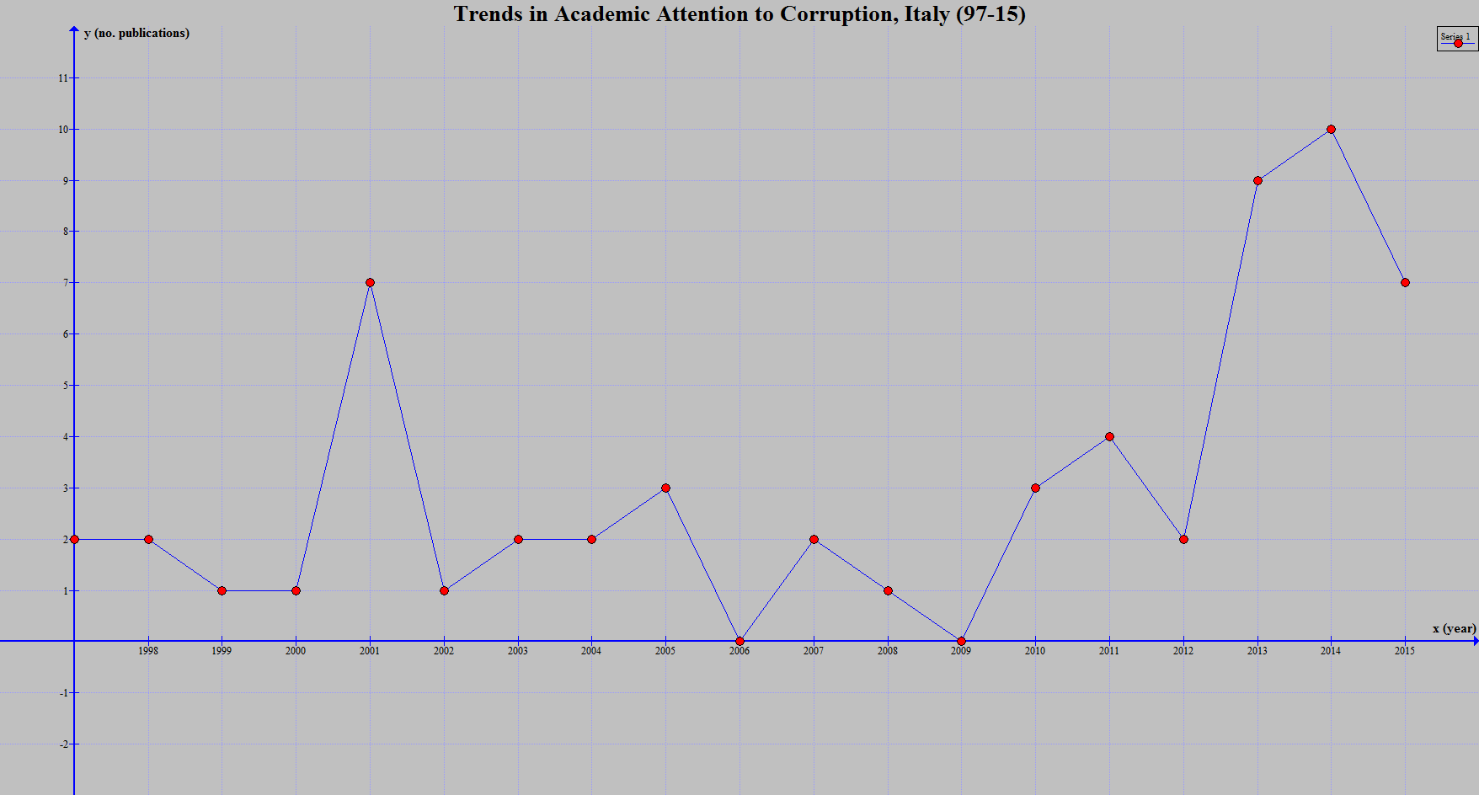
Countries Analyzed
Italy – good predictive power

Slide 14
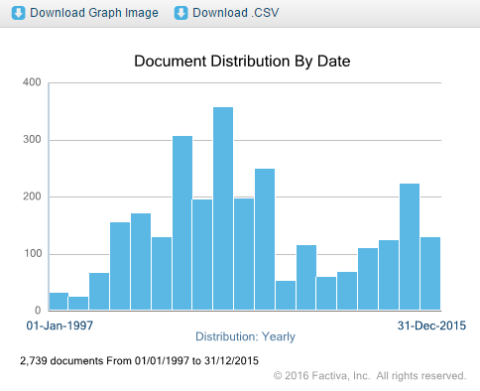
Countries Analyzed
Poland – weak and inconsistent predictive power of academia vs. internet-driven cycles

Slide 15
Intermediary Findings
Given an average of 2-year publication review time lag, Canada, Spain and Italy appear to have good academic predictive power: Canada & Spain – 2 years each, while Italy – 3 years.
Australia, France, Kazakhstan, Poland & UK appear to be lagging in terms of academic power to predict the Internet driven attention cycles in corruption: “sleep mode” in the UK & FR vs. reactionary academia in KAZ, AUS & POL

Slide 16
Content analysis
Due to time limitations, two countries are chosen for (more detailed) comparative content analysis – Italy and Spain.
Actors: Italy – primary (prosecutors, judges, parliamentarians); regular (investors, Vatican commission, US SEC, police, tax police, finance police, Audit Court;
Spain – prosecutors, judges, opposition, NGOs
Public opinion: greater weight in Italy vs Spain

Slide 17
Content analysis (2)
“Anchoring” and “focusing” events:
Italy – 3 focusing events; greater corporate lobby influence domestically and unethical behavior in some of developing nations; scandals with political figures are observed often
Spain – 1 focusing event; greater impact of domestically produced political scandals; high attention and criticism to Prime minister

Slide 18
Content analysis (3)
Types of corrupt behavior
Italy – corporate lobby and related corruption (strongest); bribery; procurement and contract; fraud; political party corruption; nepotism (low).
Spain – political party corruption (strongest), political corruption (high), corporate lobby, under-the-table payments, embezzled funds (low).

Slide 19
Conclusion & Further
Economic development status: not all developed economies appear to have scholars (epistemic communities) with sound skills in predicting coming cycles driven by the Internet
Inclusion of new actors and policy areas: other actors, e.g. think tanks, as well as new policy issues can be included to strengthen the validity of the new model.
Potential for developing into a mass-scale project

