Slide 1

Singapore Public policy Network conference 2016
Hybrid governance of aquaculture: opportunities and challenges
Joanna Vince
Politics and International Relations Program, School of Social Sciences
Institute for the Study of Social Change
University of Tasmania
Marcus Haward
Ocean and Antarctic Governance
Ocean and Cryosphere Centre, Institute for Marine and Antarctic Studies
Institute for the Study of Social Change
University of Tasmania

Slide 2
Hybrid Governance and aquaculture
Governance in the coastal and ocean domains has become increasingly complex over the last few decades - In the fisheries and aquaculture sector this has resulted in a movement from regulatory governance arrangements to a hybrid form of governance
In a hybrid governance arrangement, governmental actors are one of many sources in the decision making process. Others include non state actors such as civil society organizations and NGOs, fishermen’s cooperatives, and private businesses.

Slide 3
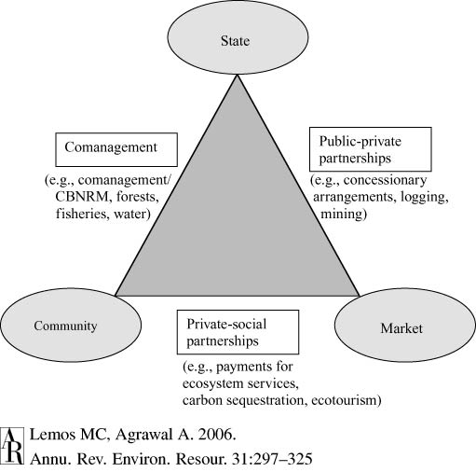
Social mechanisms in environmental governance

Slide 4
The power of the community in Hybrid governance
The community has the ability to give or take away social license or social license to operate (SLO)
Non state actors such as NGOs and/or the media can influence the community
  SLO becomes a useful tool to bring about change
  Non state actors play a strategic role in agenda setting
Industry can obtain SLO through corporate social responsibility (CSR) policies
  Can be used to gain consumer support
  Can be driven by community SLO or government regulation
  Problems include ‘greenwashing’ or ‘bluewashing’; communities become resistant to projects
Contingent consent

Slide 5
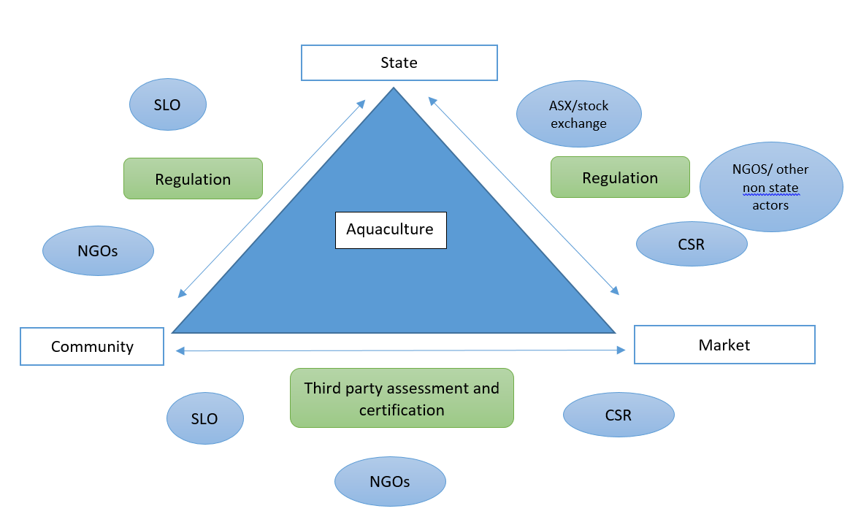
Hybrid governance of aquaculture

Slide 6
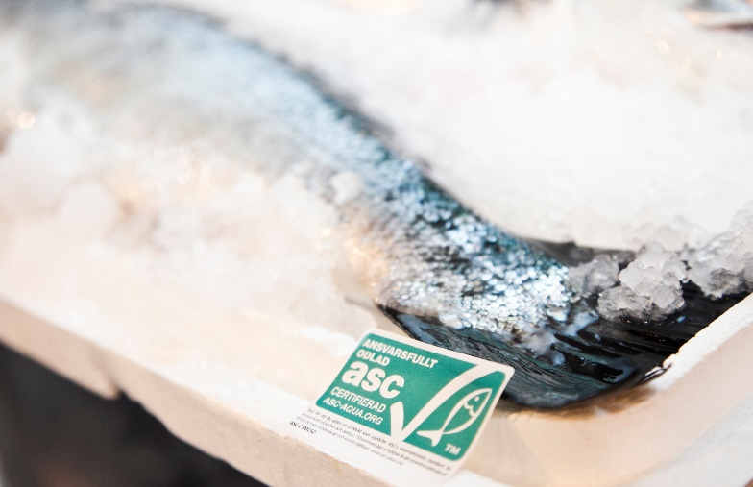
Aquaculture Stewardship Council (ASC)
The ASC an independent, non profit organisation that was established in 2010 through a collaboration of the Wildlife Fund for Nature (WWF) and the Sustainable Trade Initiative (IDF)
The ASC aims to be a world leader in aquaculture accreditation and to ‘transform the world’s seafood markets’ while promoting ‘the best environmental and social aquaculture performance’. Within two years of operation, ASC certified more than one hundred farms and by January 2016 this number had doubled (ASC 2016).
Not all groups are supportive of the ASC but studies have found that consumers are willing to pay more for eco-labelled food

Slide 7
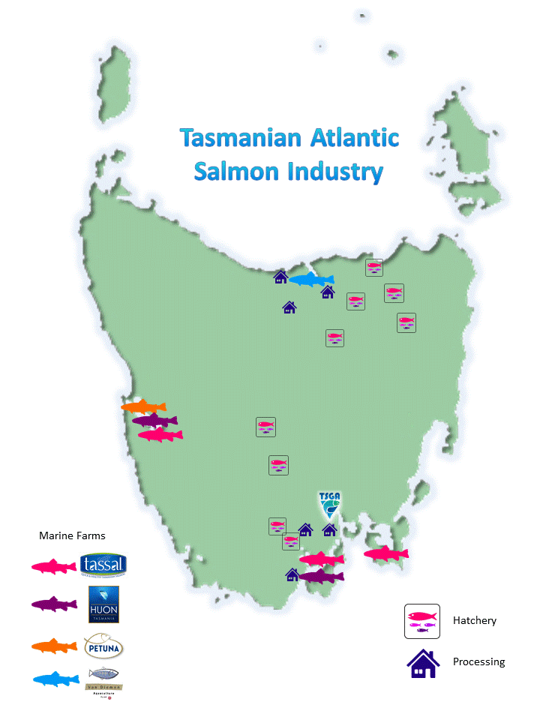
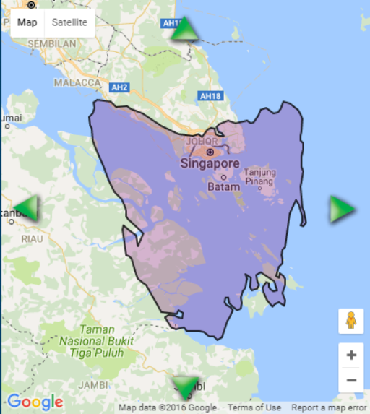
Tasmanian Case study

Slide 8
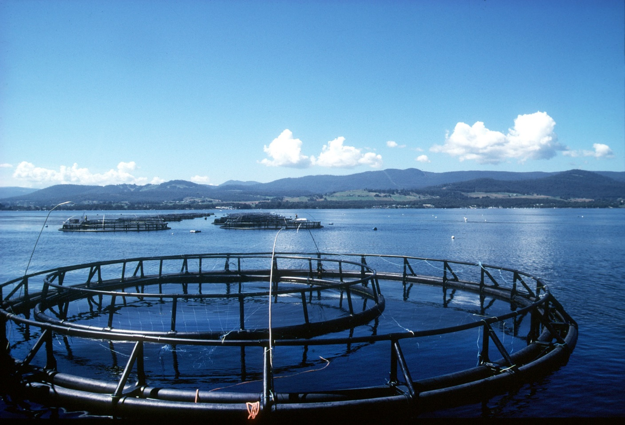
Tasmanian Aquaculture
Controversial - coastal areas, rapid expansion of the industry
Community is divided between economic growth and environmental impacts
Environmental groups and the media have been successful in influencing the affected communities
Scientific assessments are not swaying community perceptions
Other key actors in this hybrid governance arrangement:
  aquaculture industries who are also opposing salmon farming developments
  Marine Farming Review Panel
  Tasmanian Salmonid Growers Association
  Shareholders
  Tasmanian government (Senate Inquiry)

Slide 9
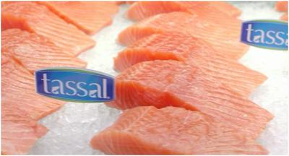
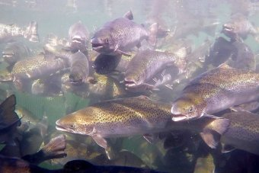
Tassal Limited
Largest salmonid company
Holds 50 percent of the domestic salmon market
Has CSR policies
In March 2015, Tassal became the first aquaculture company in the world to receive full ‘gold standard’ ASC accreditation for all its sites
Later in August that year, Tassal won the Australian Business Award for Sustainability
Community still opposed and/or divided
The CEO of Tassal Mark Ryan has stated “I don’t know what more that we can do to actually prove to people that we are doing the right thing” (Ryan 2015).

Slide 10
Lessons Learned from the hybrid governance model
aquaculture industries should not underestimate the influence of community and NGO groups and their ability to give or withhold social license
third party certification is not the only factor that can contribute to social license. In other aquaculture settings around the globe where certification and ecolabelling has provided the basis to social license, it can easily be taken away if the community doubts the scheme or the accrediting organisation.
contingent consent will not always exist even it has been given at a previous time
the market is changing, and CSR and shareholder expectations tend to align with practices that are socially and environmentally acceptable

Slide 11
Conclusions: ways forward
With the increasing reliance on aquaculture produce as the source of seafood consumption around the world, the aquaculture sector in Australia is forecast to grow.
Managing this growth at sustainable levels can best occur through the coordination of efforts through a hybrid governance approach where communities, markets and the state work together.
The importance of third party certification organisations and schemes is not to be underestimated as a tool for future aquaculture development. However, schemes such as the ASC are in their infancy and they too will need to evolve along with the demands of the market and state regulatory measures.

