Slide 1
Energy security and regional power sector cooperation in the Greater Mekong Subregion:
Past developments and near-term challenges
Daniel del Barrio Alvarez
The University of Tokyo, Civil Engineering
Singapore Public Policy Network Conference. August 27, 2016
http://www.crowdfundinsider.com/2016/03/83070-asia-pacific-research-dramatic-growth-in-alternative-finance-is-fueled-by-huge-china-market/

Slide 2
Outline
Greater Mekong Subregion Energy Security Challenge
Rationale for power cooperation in the GMS
The GMS power cooperation program
Challenges and recent developments
Analysis of the development process
Summary

Slide 3
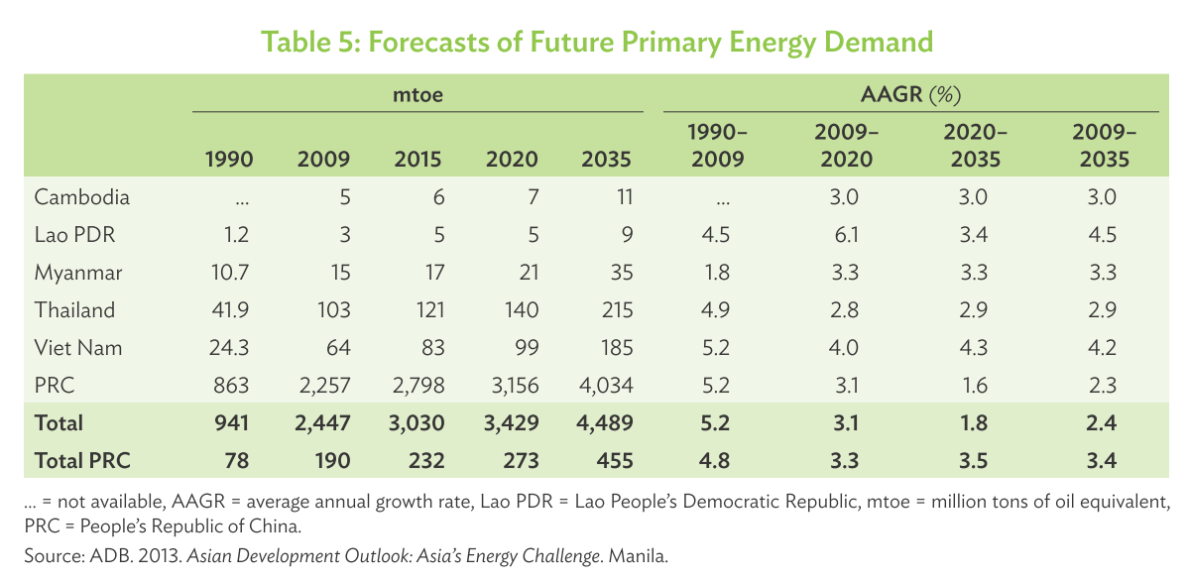
Greater Mekong Subregion Energy Security Challenge
Rapid demand growth in the Greater Mekong Subregion:
In 2035 about 80% higher than current levels
World average of 1.5% average annual growth
Increasing dependency on imported fossil fuels
Security of future energy demand in GMS needs to be addressed

Slide 4
Rationale for power cooperation in the GMS
Energy security relies on three pillars:
Regional power sector integration benefits:
Enhance energy security
Bring economies-of-scale in investment
Facilitate financing
Enable greater renewable energy penetration
Allow synergistic sharing of complementary resources
Power supply trilemma
Energy Security
Adequacy and reliability of physical energy supply
Environmental sustainability
Affordable access
Sustainability
Affordability
Availability
Source: ADB, 2013
Source: IEA, 2015
Source: World Bank, 2010
Power cooperation can serve to address the energy trilemma

Slide 5
Rationale for power cooperation in the GMS
PRC
Export of electricity
Import to supply Guangdong
Myanmar
Large hydro-power potential
Underdeveloped sector
Lao PDR
Large hydro-power potential
Lack of financial resources
Viet Nam
Thailand
Power surplus in South
Deficit in North
Import electricity
Diversify energy mix
Reduce need of coal-fired
Cambodia
Import cheaper power
Develop hydro
GMS independent power systems are highly complementary

Slide 6
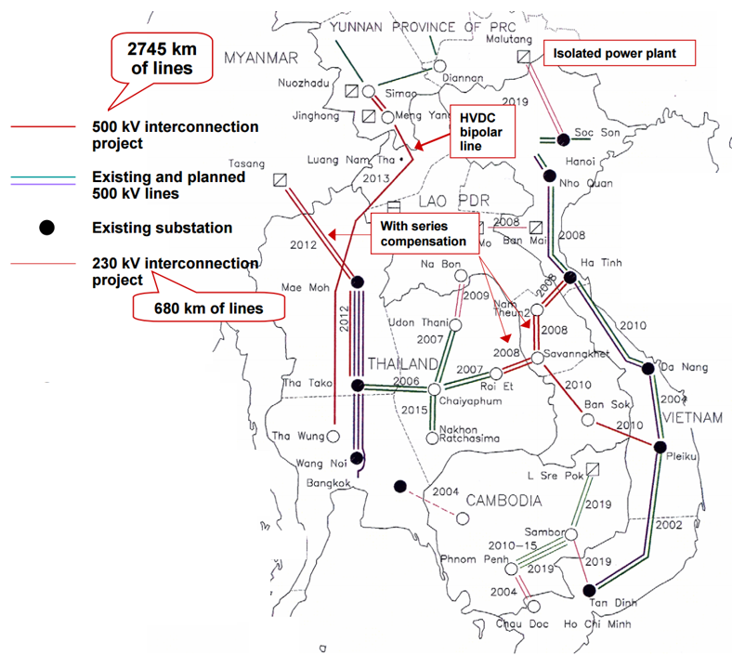
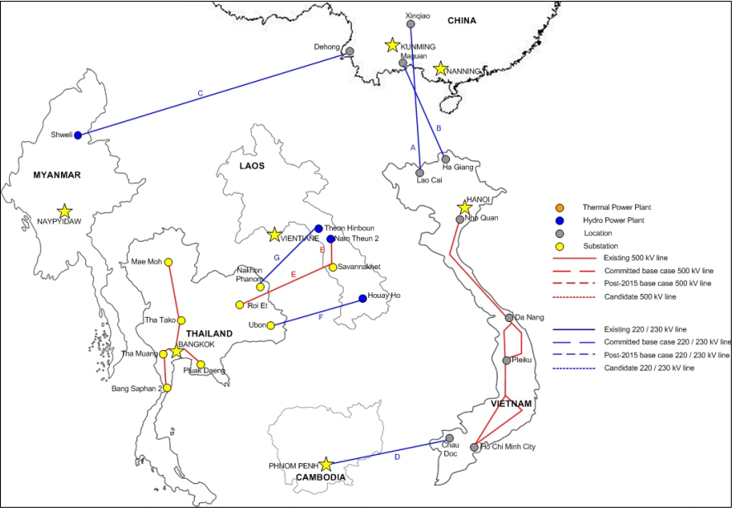
Rationale for power cooperation in the GMS
ADB (2009) quantified potential benefits of power cooperation:
19% reduction of overall energy costs by 19% up to 2030
5.5% of total energy consumption reduction in overall dependence on imported resources
40% lower coal-based power generation capacity
Greater integration of renewable energy sources and other off-grid
Regional Indicative Master Plan (2002)
Existing interconnections (by 2009)
Source: UNDESA, 2005
Source: ADB, 2010
Regional power trade can support GMS to address power trilemma

Slide 7
The GMS Power Cooperation Program
1992, First GMS Ministerial meeting
2002, Inter-Governmental Agreement (IGA)
2005, a gradual four stages process was agreed:
Stage 1: Bilateral cross-border connections through PPAs;
Stage 2: Grid-to-grid power trading between any pair of GMS countries
Stage 3: Development of transmission links dedicated to cross-border trading
Stage 4: Most of the GMS countries have moved to multiple sellers-buyers
Source: ADB, 2016
GMS regional power trade has grown through bilateral agreements

Slide 8
Challenges and recent developments
Progress has remained stuck at Stage 1
Recent developments seem to indicate a renewed effort for strengthening the institutional structure of GMS power trade:
Updating of Regional Master Plan (2010 -)
Negotiations for establish of Regional Power Coordination Center (RPCC) (2011 - )
“The high-volume trans-boundary connections that have been made to date within the GMS do not achieve a true interconnection of systems with synchronous operations, but are simply an extension of the national grids of the large-consuming countries into the territories of producers of (mainly) hydropower”
Source: ADB (2013), “Assessment of the GMS Energy Sector Development”
Identifying influential factors during the entire process can serve to better address the key issues of the near-term future

Slide 9
Analysis of the development process
Initial GMS conferences
[1992 -1993]
1
Signing of Inter-Governmental Agreement {IGA}
[2002]
2
Signing of MOU-1 for Stage 1
[2005]
Signing of MOU-2 for Stage 2
[2008]
4
Establishment of Electric Power Forum (EPF)
[1995]
Adoption of Policy Statement
[1999]
EPF replaced by Subregional Energy Forum (SEF)
[2005]
RETA 6440; Update Regional Indicative Master Plan [2010]
RETA 5535; Subregional
Energy Sector Study
[1993-1995]
Establishment of Experts Group on Regional Power Trade and Interconnection (EGP)
[1998]
EGP replaced by Regional Power Trade Coordination Committee (RPTCC)
[2004]
Negotiations for establishment of Regional Power Coordination Center [2011 – ]
Regional Power Trade Operating Agreement
[2002-2004]
World Bank’s Power Trade Strategy for GMS
[1999]
RETA-5920; Regional Indicative Master Plan
[2000-2002]
Focal Group (FG) and Planning Working Group
[2005]
List of priority projects
and initial bilateral contacts [1993-1994]
3
Bilateral power agreements based on MOUs and IPPs
RETA 6301; Regional Energy Sector Strategy (ESS) [2006-2008]

Slide 10
Phase 1: National stakeholders’ agreement
1991 – Xeset hydro power plant as forerunner project
First cross-border project in the region after Indochina war
45 MW in southern Lao, power purchase agreement with EGAT (Thailand)
1993 – First GMS Ministerial Conference in Manila (ADB HQ)
Participation of representatives from the six member countries
1995 –Subregional Electric Power Forum (EPF) established
Advisory body to the GMS Ministers
Two representatives from each country (one senior official from respective ministers, and one senior management for the state-owned power utilities)
Two technical assistance studies by donors
ADB, Subregional Energy Sector Study
First study of energy sector covering the entire region
World Bank, Power Trade Strategy for GMS
Identification of barriers to trade

Slide 11
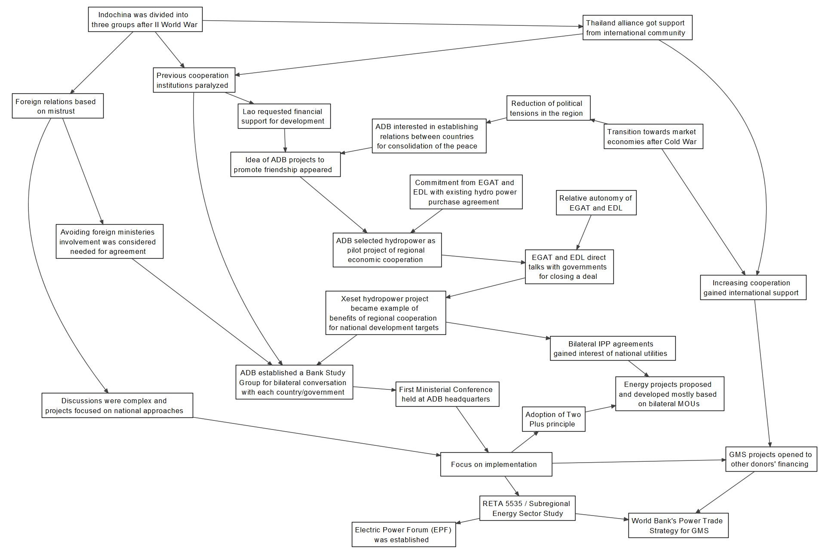
Analysis of phase 1: causality diagram

Slide 12
Analysis of phase 1: influential factors
Involvement of ADB as a neutral partner
Commencement of the negotiations at technical level

Slide 13
Summary of analysis of four phases
Phase | Description | Influential factors
1, National stakeholders’ agreement | ADB bilateral contacts First GMS Ministerial meeting Initial studies Establishment of EPF and EGP | Involvement of ADB as neutral partner Commencement of the negotiations at technical level
2, High-level political agreement | Adoption of Policy Statement Signing and ratification of Inter-Governmental Agreement (IGA) | Strong focus on regional ownership of the program Gradualism principle
3, Physical construction | Construction of dedicated transmission lines based on bilateral MOUs and/or power purchase agreements | Active involvement of state-owned utilities and related ministries Absence of regional mindset in the development of new projects
4, Institutional construction | Establishment of RPTCC Sign of MOU #1 and MOU #2 Updating Regional Master Plan | Emphasis on inter-governmental approach Lack of coordination of PDPs
Influential factors identified for each of the four phases

Slide 14
Near-term future
Current discussions are being held around:
Establishment of the Regional Power Coordination Center (RPCC)
“A permanent dedicated center envisioned to coordinate power trade”
Promotion of regional vision among national experts:
Granting independence through independent budget and full time employees
Incorporating experts from state-owned utilities (understanding of national and regional contexts)
Utilization of updated Regional Master Plan
Identification of projects to develop
Addressing of unbalances (particularly of large hydro power plants)
Effects on local population and environment
Effects on riparian countries (Mekong)
Avoiding “Dutch disease”
Based on understanding of previous influential factors, recommendations for near-term future key issues are proposed

Slide 15
Summary
Establishment of regional power market in the GMS could strengthen energy security for all member countries
Addressing the power trilemma
Regional power trade has grown dramatically during past 25 years
But, difficulties are being faced to move forward the process
Influential factors in the process have been identified through causality diagrams for each phase
Recommendations have been derived for the near-term future
Thank you for your attention

