Slide 1

Singapore Public Policy Network Conference
26-27 August 2016
How to drive Public Service Innovation in the Korean and and Chinese Public Sectors? : Exploring the roles of human and social capital
Hyo Joo Lee, Ph.D. Student
Min Young Kim, Ph.D. Candidate
Research Center for Public Human Resource Development, Sungkyunkwan University, Korea

Slide 2
How to drive Public Service Innovation
in the Korean and Chinese Public Sector?
I
Introduction
II
Theoretical Framework
III
Research Method
IV
Statistical Modeling & Results
V
Discussions

Slide 3

1. Introduction
Research Background
Clark(1987)
“Innovation should be at the center of the study of organizations.”
(Van de Ven & Rogers, 1988, p.635)
Org. Innovation
Not Optional But Inevitable

Slide 4



1. Introduction
Research Question
Org. Innovativeness
1
Are there similarities and differences among the PSM, human and social capital, and org. innovativeness?
2
Do the public employees’ policy making PSM, and altruism PSM have positive effects on human capital and social capital?
3
Do human capital and social capital play a positive role in fostering organizational innovativeness?

Slide 5
How to drive Public Service Innovation
in the Korean and Chinese Public Sector?
I
Introduction
II
Theoretical Framework
III
Research Method
IV
Statistical Modeling & Results
V
Discussions

Slide 6

2. Theoretical Framework
Organizational Innovativeness
Lumpkin and Dess(1996)’s definition
“an organization’s willingness, tendency, and ability to engage in and support new ideas, novelties, experimentation and creative process that may result in innovations”
(Riivari et al., 2012, p.13)
Innovativeness

Slide 7


2. Theoretical Framework
The Effect of Public Service Motivation (PSM) on Human Capital
Self-Determination Theory
PSM
In-role performance
Intrinsic
Motivation
Creativity
Policy making PSM
Altruism PSM
“investigation of people’s inherent growth tendencies and innate psychological needs that are the basis for their self-motivation and personality integration, as well as for the conditions that foster those positive processes”(Ryan & Deci, 2000, p. 68)

Slide 8

2. Theoretical Framework
The Effect of Public Service Motivation (PSM) on Social Capital
Stewardship Theory
PSM
Trust
Intrinsic
Motivation
Reciprocity
Policy making PSM
Altruism PSM
“situation in which managers are not motivated by individual goals, but rather are stewards whose motives are aligned with the objectives of their principals”(Davis et al., 1997, p. 21).
Notes:
To be specific, employees with high level of interest in public goods, humanism, well-being of all citizens have a tendency to behave pro-socially in the organization, that formulates trust and reciprocity.

Slide 9


2. Theoretical Framework
The Effect of Human & Social Capital on Org. Innovativeness
Resource Based View
No imitable
No transferable
No substitutable
Resource
Org. sustaining
competitive advantage
Human Capital
Social Capital

Slide 10
How to drive Public Service Innovation
in the Korean and Chinese Public Sector?
?
I
Introduction
II
Theoretical Framework
III
Research Method
IV
Statistical Modeling & Results
V
Discussions

Slide 11
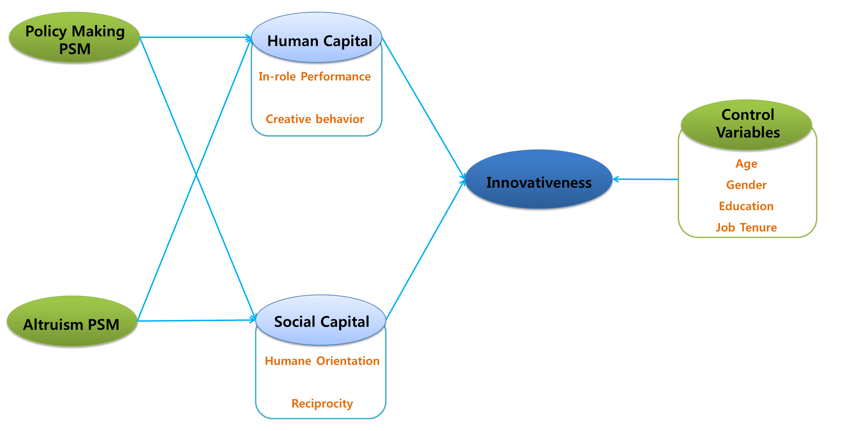
3. Research Method
Research Framework

Slide 12
3. Research Method
Data and Sample

Slide 13
3. Research Method
Data and Sample

Slide 14
How to drive Public Service Innovation
in the Korean and Chinese Public Sector?
I
Introduction
II
Theoretical Framework
III
Research Method
IV
Statistical Modeling & Results
V
Discussions

Slide 15
4. Statistical Modeling and Results
Reliability Test and CFA Results

Slide 16
4. Statistical Modeling and Results
Reliability Test and CFA Results

Slide 17
4. Statistical Modeling and Results
Independent Sample t Test

Slide 18
4. Statistical Modeling and Results
Independent Sample t Test

Slide 19
4. Statistical Modeling and Results
Correlation Analysis-KOREA
**p < 0.01
Notes: 1.Age, 2.Gender, 3.Education, 4.Job Tenure, 5. Policy Making PSM, 6. Altruism PSM, 7.Human Capital, 8. Social Capital, 9. Organizational Innovativeness

Slide 20
4. Statistical Modeling and Results
Correlation Analysis-CHINA
**p < 0.01
Notes: 1.Age, 2.Gender, 3.Education, 4.Job Tenure, 5. Policy Making PSM, 6. Altruism PSM, 7.Human Capital, 8. Social Capital, 9. Organizational Innovativeness

Slide 21
4. Statistical Modeling and Results
Model Fit

Slide 22
4. Statistical Modeling and Results
Standardized Total and Direct Effects-KOREA
***p < 0.001

Slide 23
4. Statistical Modeling and Results
Standardized Total and Direct Effects-CHINA
***p < 0.001

Slide 24
4. Statistical Modeling and Results
Result of Sobel Test

Slide 25
How to drive Public Service Innovation
in the Korean and Chinese Public Sector?
I
Introduction
II
Theoretical Framework
III
Research Method
IV
Statistical Modeling & Results
V
Discussions

Slide 26
5. Discussions
Discussions
1a, 1b, 2b | Confirmed | PSM is an important cultivator and activator among Korean and Chinese public agencies in increasing their employees’ human capital
2a | Rejected | policymaking PSM negatively, significantly related with human capital in Chinese public sectors.
3a, 3b, 4b | Confirmed | the two types of PSM may cultivate and activate social capital in Korean and Chinese public agencies.
5, 6, 7, 8 | Confirmed | the human or social capital is crucial factors, which effectively boosts organizational innovativeness in Korean and Chinese public sectors.

Slide 27
5. Discussions
Implication & Limitation
Established a theoretical literature of organizational innovativeness, and developed a theory of explaining the antecedents of organizational innovativeness by adapting self-determination theory, stewardship theory, and RBV.
1
2
Managers should carefully reconsider PSM as a precondition for organizational innovativeness.
1. employees who intentionally internalize PSM seem bound to search for interest, fun, and happiness in their work itself, which will ultimately support and increase their organizational innovativeness. .
2. when designing the public employee’s training and development, managers and organizations should focus on how to increase and express the employee’s PSM in the workplace.

Slide 28
5. Discussions
Implication & Limitation
3
Organization should be considering the way to utilize of organizational capital, such as human and social capital.
In order to manage the human capital in public sectors, they have to adapt and design individual and career development path based on individual competence.
organization needs to set the conflict management to maintain reciprocity or trust in their organization.
1
Common method bias cannot be fully eliminated.

Slide 29
Thank you

Slide 30
Appendix
Items for main variables
Public Service Motivation
* Policy making PSM
1. I have a negative perception on politics. (R)
2. The compromises that are involved in public policymaking don’t appeal to me. (R)
3. I don’t care much for politicians. (R)
* Altruism PSM
1. It is hard for me to get intensely interested in what is going on in my community. (R)
2. I unselfishly contribute to my community.
3. Meaningful public service is very important to me.
4. I consider public service my civic duty.
5. Making a difference in society means more to me than personal achievements.
6. I believe in putting duty before self.
7. Much of what I do is for a cause bigger than myself.
8. Serving citizens would give me a good feeling even if no one paid me for it.
9. Most social programs are too vital to do without.
10. It is difficult for me to contain my feelings when I see people in distress.
11. To me, patriotism includes seeing to the welfare of others.

Slide 31
Appendix
Items for main variables
Human Capital
In-role Performance (Williams & Anderson, 1991; Neubert, 2008)
1. I adequately complete assigned duties.
2. I perform the tasks that are expected of me.
3. I meet formal performance requirements for my job.
4. I engage in activities that will directly affect my performance.
Creative Engagement(Zhou & George, 2001; Zhang & Bartol, 2010)
1. I suggest new ways to achieve goals or objectives.
2. I come up with new and practical ideas to improve performance.
3. I search out new policy and civil service ideas.

Slide 32
Appendix
Items for main variables
Social Capital
Humane Orientation (House et al., 2004)
1. In our agency, employees are generally concerned about others.
2. In our agency, employees are generally sensitive toward others.
Reciprocity (Monkhouse et al., 2012)
1. The practice of ‘give and take’ of favor is an important part of social relationships.
2. I feel a sense of obligation to a person for doing me a favor.
3. It is a bad manner not to return favors.
4. When I receive a big favor, I try to go an extra mile to do something nice in return.

Slide 33
Appendix
Items for main variables
Organizational Innovativeness (Covin & Slevin, 1989; Diefenbach, 2011)
1. My agency in its entirety is open to innovations.
2. My agency in its entirety is creative.
3. My agency in its entirety is innovative.
4. My agency in its entirety often implements new approaches to meet its responsibilities.

